Slide 1
Naive Bayes Classifier
1. Introduction
  Bayes’ Theorem
  Prior, Likelihood, Posterior
  Precision, Recall, F1-score
2. Code Implementation

Slide 2
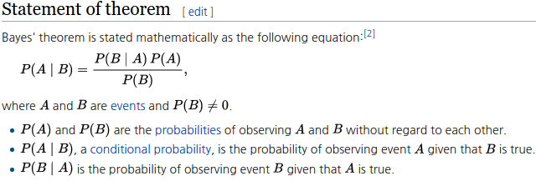
Intro. Bayes Theorem

Slide 3
Intro. Prior, Likelihood, Posterior
Prior
  probability distribution that would express one's beliefs about this quantity before some evidence is taken into account
  ex) P(M): probability of model
Likelihood
  function of the parameters of a statistical model given data
  ex) given data D, f(M) = P(D|M)
Posterior
  conditional probability that is assigned after the relevant evidence or background is taken into account
  ex)P(M|D)

Slide 4
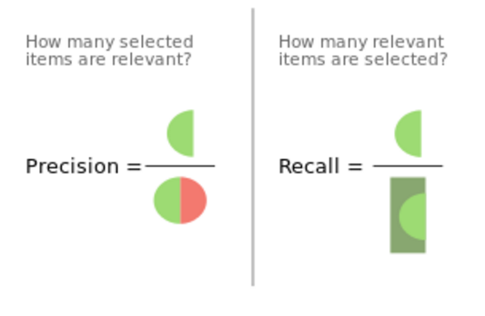
Intro. Precision, Recall, F1-score

Slide 5
Code Implementation

